Slide 1
An Investigation into QFT Digitisation Methods
for Quantum Computers

Slide 2
Why?
Noisy Intermediate-Scale Quantum era (NISQ Era)
QFT
Other Errors (Digitisation)

Slide 3
What’s already been done?
[1] Digitization of Scalar Fields for Quantum Computing by Klco and Savage
More Foundational Works:
[2] Quantum Algorithms for Quantum Field Theories by Jordan, Lee and Preskill
[3] Simulating collider physics on quantum computers using effective field theories by Bauer and Nachman
[4] Quantum simulations of one dimensional quantum systems by Somma

Slide 4
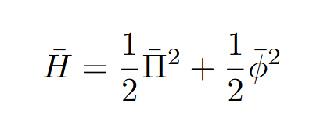
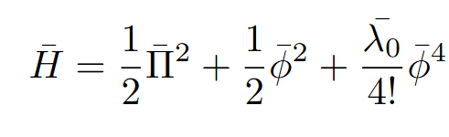
Errors
Isolate digitisation errors - Use known ground state energies

Slide 5
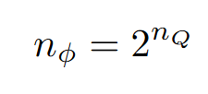


Qubits
For a given Quantum Computer: where n_{s} is the number of possible states able to be represented by a number of qubits n_{Q}

Slide 6
3 Methods of Digitisation
[1,2]
Jordan-Lee-Preskill
Finite Difference
Harmonic Oscillator Basis

Slide 7

Jordan-Lee-Preskill
+∞
-∞

Slide 8


Jordan-Lee-Preskill
+∞
-∞

Slide 9


Jordan-Lee-Preskill
+∞
-∞

Slide 10
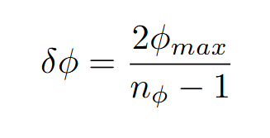
Jordan-Lee-Preskill
+∞
-∞

Slide 11

Jordan-Lee-Preskill
+∞
-∞
(constructed as diagonal matrix of values of )

Slide 12


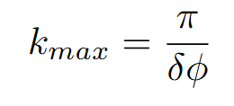

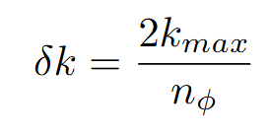

Jordan-Lee-Preskill
+∞
-∞

Slide 13
Jordan-Lee-Preskill
+∞
Still in Momentum Space
-∞

Slide 14

Jordan-Lee-Preskill
Quantum
Fourier
Transform
In momentum space
In field space
(make a unitary fourier matrix using our matrix which transforms between field and momentum space) [1]

Slide 15
Jordan-Lee-Preskill

Slide 16
Finite Difference (FD)

Slide 17
Finite Difference (FD)
+∞
-∞

Slide 18
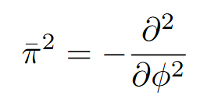
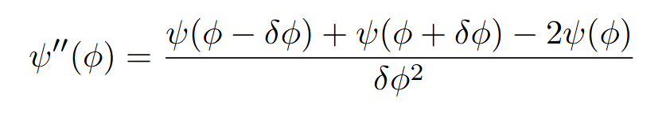
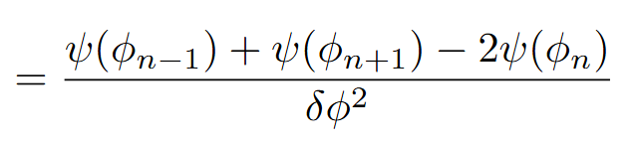
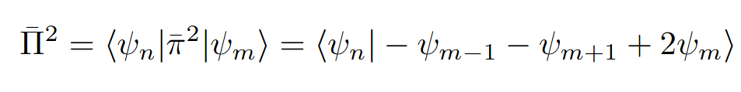
Finite Difference (FD)
Operator
Finite Difference Approximation
Combination

Slide 19
Finite Difference (FD)

Slide 20
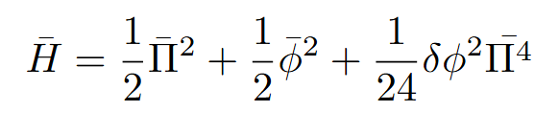
Finite Difference Corrected (FDC)

Slide 21
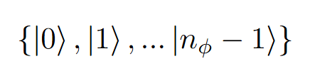
Harmonic Oscillator Basis
We choose to work in a truncated set of harmonic oscillator eigenstates:
Assume: true low energy states of our hamiltonian can be approximated by a linear combination of these states

Slide 22
Harmonic Oscillator Basis
How do we express and in terms of these states?

Slide 23
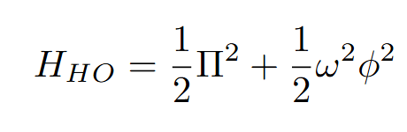
Harmonic Oscillator Basis
How do we express and in terms of these states?

Slide 24
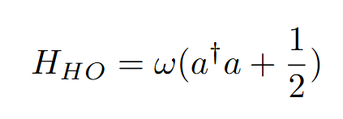
Harmonic Oscillator Basis
How do we express and in terms of these states?

Slide 25
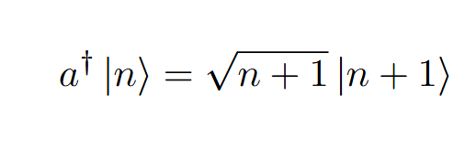
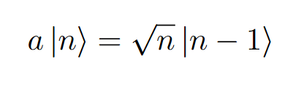
Harmonic Oscillator Basis

Slide 26
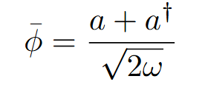
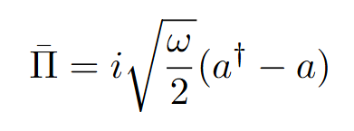
Harmonic Oscillator Basis

Slide 27
Harmonic Oscillator Basis

Slide 28
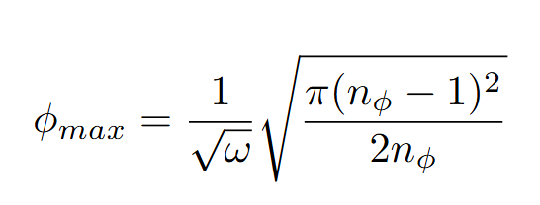
Nyquist-Shannon Sampling Theorem
[3,4]
Variables are related to each other
End up with a balancing issue
JLP (/FDC):
HO Basis:

Slide 29
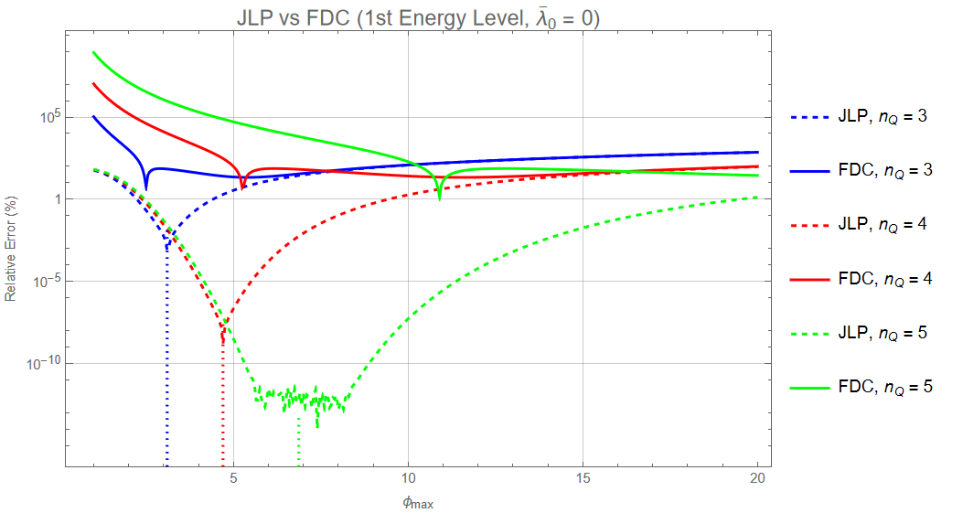
Results
[1]
Graphs How to interpret them

Slide 30
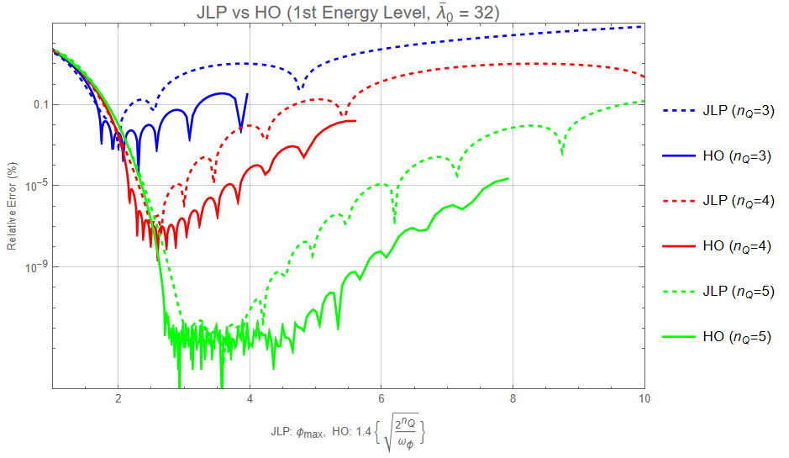
Results
[1]
Graphs How to interpret them

Slide 31
Looking forward, HTET what is it?
[5] - Hamiltonian Truncation Effective Theory by Cohen, Farnsworth, Houtz, Luty

